Slide 1
Book subscription analysis: Analyzing Customer Behavior
By: Fadeke Babatunde
DataLab Analytics Internship Program, Jan. 2023

Slide 2
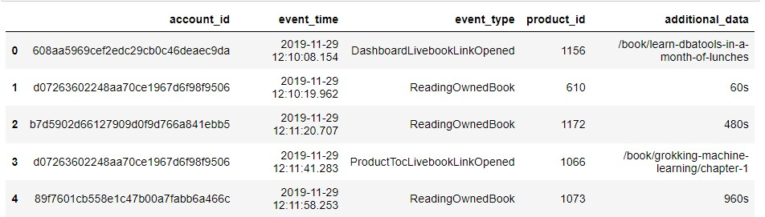
Summary 0f Features for the Book Subscription Data using Python for analysis.

Slide 3
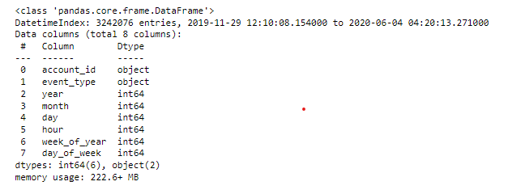
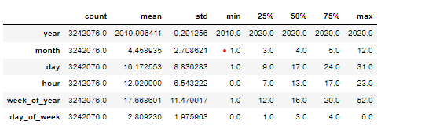
Data Preparation and Analysis
The dataset has 3242076 rows and 10 columns. Converted the event time from object using date time.
The event time ranges from 2019-11-29 12:10 to 2020-06-04 04:20
I dropped rows containing NaN values which is to scale down the data due to my computing resources (“additional data”) and also redundant features: (“product_id”)
Event time was broken down into features into year, month, day, hour and weeks for better analysis

Slide 4
OBJECTIVES
• What events are most common?
• What events are least common?
• Get the account id with the highest number of events.
• Get the account id with the least number of events.
• How many times events occurred based on different times of the day

Slide 5
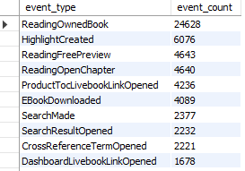
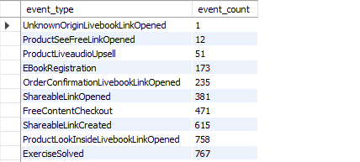
Most common and Least common Event Type on my SQL query.

Slide 6
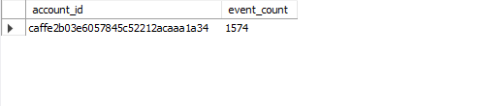
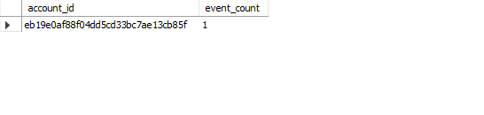
ACCOUNT_ID OF THE HIGHEST AND LEAST NUMBER OF EVENTS

Slide 7
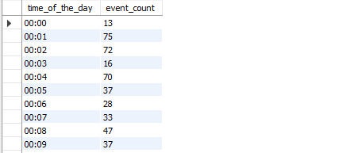
Number of Times events occurred based on different times of the day

Slide 8
Brief Overview of SQL queries
Most common type of event of the subscribers is ReadingOwnedBook with 24,628 count
The least common type of event of the subscribers is UnknownOriginLivebookLinkOpened with 1 count
The account id with the highest number of events is caffe2b03e6057845c52212acaaa1a34
The account id with the least number of events is eb19e0af88f04dd5cd33bc7ae13cb85f

Slide 9
Recommedations
More features should be added to the analysis which can help us understand customer behavior like location , genre of book , author of book
Since Customers are more likely to read owned books ,the company can invest more in marketing and advertising of Books to get more traffic on the platform.

